Slide 1
ASCO Certified Patient-Centered Cancer Care Standards

Slide 2
Agenda
Introductions
Oncology Medical Home: Background and Standards
ASCO Certified
Questions/Discussion
© 2024 Association for Clinical Oncology (ASCO). All Rights Reserved Worldwide.

Slide 3
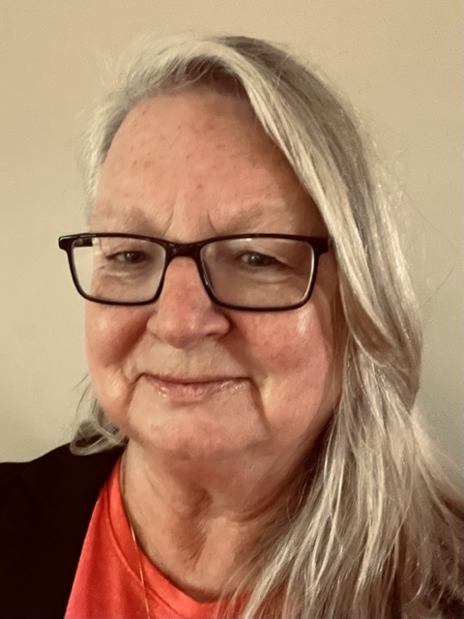
Speakers
Ronda Bowman, MHA, RN, OCN
Sr. Director, ASCO Certification Programs
ASCO Care Delivery
Bo Gamble, BS
Champion Quality &
Value in Cancer Care
Veronica Gorman, MBA
Senior Program Manager, ASCO Certified
ASCO Care Delivery

Slide 4
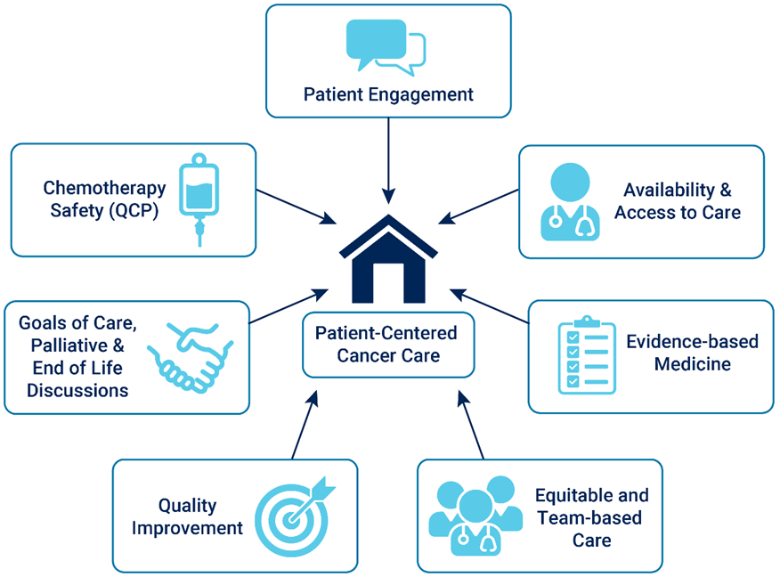
ASCO Certified: Evidence, Quality, Value and Benefit
ASCO Certified is a new program powered by ASCO/COA Oncology Medical Home
That certifies outpatient oncology group practices and health systems that meet a single set of comprehensive, evidence-based ASCO-COA oncology medical home standards (OMH).
These standards and certification have been shown through a pilot program to be a value and benefit to practices, patients, and payers.
By using the OMH standards, ASCO Certified provides an objective measurement for high-quality cancer care, that may reduce administrative burden for practices, and can result in efficiencies and cost savings.
17 medical home standards
22 chemotherapy safety standards
Program Opened Nationally July 2023
Applicants Being Accepted
© 2024 Association for Clinical Oncology (ASCO). All Rights Reserved Worldwide.

Slide 5
Collaboration between ASCO and COA Leaders in Cancer Care Quality and Value Efforts
Community Oncology Alliance (COA)
Mission: Ensuring patients receive quality, affordable, and accessible cancer care in their own communities
Non-profit organization dedicated to advocating for community oncology patients and practices
Built a national grassroots network of community oncology practices to advocate for public policies that benefit patients
Development of core Oncology Medical Home standards
American Society of Clinical Oncology (ASCO)
Mission: conquering cancer through research, education, and promotion of the highest quality, equitable patient care
World’s leading professional organization for physicians and oncology professionals caring for people with cancer
Membership: over 45,000 oncology professionals
18 standing volunteer committees to advance ASCO programs, resources, and services
Successful certification experience with QOPI Certification Program

Slide 6
Oncology Medical Home Background and Standards

Slide 7
Patient Centered Medical Home Definition Agency for Healthcare Research and Quality (AHRQ)
Comprehensive Care
Accountable for meeting patient’s physical and mental health needs
Requires team-based care
Patient Centered
Relationship-based care with emphasis on the person and family
Coordinated Care
Across all elements of the broader health system
Accessible Care
Shorter time for urgent needs, 24/7 access, alternative methods of communication
Quality and Safety
Performance measurement and improvement
Evidence based care
Measuring and responding to patient experience and satisfaction
© 2024 Association for Clinical Oncology (ASCO). All Rights Reserved Worldwide.

Slide 8
Oncology Medical Home and Patient-Centered Cancer Care Certification
Applies care knowledge to support patient preferences, needs, and values
Applies learnings and findings from previous initiatives to form a meaningful program that identifies and promotes quality cancer care for all that support that journey.
Establishes high quality cancer care
A care delivery system that proves high quality, evidence-based cancer care with measurement.
Reinforces continual improvement
Reinforces on-going quality cancer care with ongoing assessment and continual improvement.
Standardization
Standard and consistent platform for quality cancer care for national, regional and local payers that are reformist in payment methodology.
Clinical and Financial
Clinical and financial information for a transparent views of quality and value in cancer care.
© 2024 Association for Clinical Oncology (ASCO). All Rights Reserved Worldwide.

Slide 9
Oncology Medical Home (OMH) Standards Development
The ASCO-COA OMH standards were developed based on:
consensus of a multidisciplinary Expert Panel:
clinicians
health system administrators
patient advocates.
a systematic review of evidence including
comparative peer-reviewed studies
studies of clinical pathways
systematic review of survivorship care plans
Standards approved by COA’s Payment Reform Committee and the ASCO Board of Directors.
Published in JCO-OP August 2021
17 medical home standards
22 chemotherapy safety standards
© 2024 Association for Clinical Oncology (ASCO). All Rights Reserved Worldwide.

Slide 10
ASCO Certified Patient-Centered Cancer Care Standards

Slide 11
Success in Value-Based care
Innovations in alternative payment models need complimentary innovations in care delivery in order to achieve meaningful savings and improve quality
Payment Model
Care Delivery System
Center Medicare & Medicaid Innovation
Oncology Care Model
Enhancing Oncology Model
Commercial Payers
Aetna
Blue Cross Blue Shield Plans
Cigna
Elevance Health
Humana
UnitedHealthcare
ASCO Certified
Patient-Centered Cancer Care Standards
© 2024 Association for Clinical Oncology (ASCO). All Rights Reserved Worldwide.

Slide 12
Why “Certification”?
Go from “Of course I am” to “I can prove it”
Promotes credibility
Within the team
Patients
Insurance companies/employers
Unifies team effort
Can blame someone else for the change ☺
Develops a Continuous Quality Improvement mindset
Standardizes quality cancer care for all that are involved
Approved by a reputable third-party source – ASCO
© 2024 Association for Clinical Oncology (ASCO). All Rights Reserved Worldwide.

Slide 13
Oncology Medical Home Standards Overview

Slide 14
Oncology Medical Home Standards
Patient Engagement
Education about Oncology Medical Home
Financial counseling
Education on diagnosis and treatment
Survivorship Care Program
Availability & Access to Care
*Expanded access to care; symptom triage
*Emergency department, hospital admission & readmission data analysis; post-discharge follow-up
Follow up for missed or cancelled appointments
*more challenging standards
© 2024 Association for Clinical Oncology (ASCO). All Rights Reserved Worldwide.

Slide 15
Oncology Medical Home Standards
Equitable and Comprehensive Team-Based Care
Medical oncologist directed care team; care coordination
Team functioning, performance, and communication
*Navigation Services/Psychosocial Assessment
*Health Equity Assessment
Evidence Based Medicine
*Oncology Clinical Pathway treatment planning and reports on physician compliance
Clinical research trials access and participation
*more challenging standards
© 2024 Association for Clinical Oncology (ASCO). All Rights Reserved Worldwide.

Slide 16
Oncology Medical Home Standards
Quality Improvement
Patient experience survey and analysis
*Quality improvement, analysis and sustainability
*Electronic health record core data completeness and quality measures
Goals of Care, Palliative and End of Life Care Discussions
*Advance care planning
*Goals of care discussions; end-of-life care; Access to Palliative Care
Chemotherapy Safety
*Quality Oncology Practice Initiative (QOPI) Certification Program or Chemotherapy Safety Standards Compliance
*more challenging standards
© 2024 Association for Clinical Oncology (ASCO). All Rights Reserved Worldwide.

Slide 17
ASCO Certified Pilot and Results

Slide 18
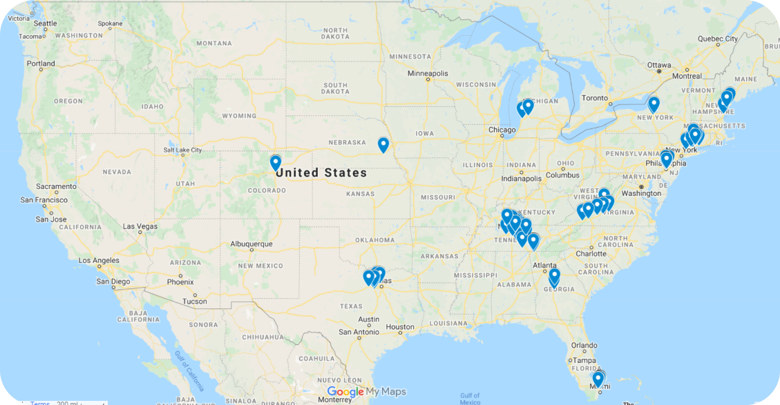
ASCO Certified Pilot
Certification Standards adopted from Oncology Medical Home Standards and certification manual created
Certification Pilot July 2021 to June 2023
12 practices (95 sites, 492 oncologists)
2 commercial payers engaged (Elevance, Cigna)
Policy review, on-site survey, and compliance documentation
EHR- and claims-based measures during and after certification process, clinical pathway utilization and reporting, patient experience
Pilot Certifications awarded
All 12 Practices certified with evidence of practice transformation
Positive patient experience and value to practices
Payer and Employer interest and recognition for value–based care
Program Opened Nationally July 2023
© 2024 Association for Clinical Oncology (ASCO). All Rights Reserved Worldwide.

Slide 19
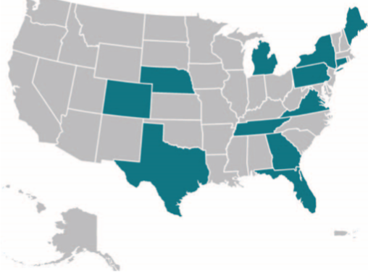
ASCO Certified
Pilot Practices Included:
Blue Ridge Cancer Care, Roanoke, VA.
Cancer & Hematology Centers of Western Michigan, Grand Rapids, MI.
Central Georgia Cancer Care, Macon, GA.
Hematology-Oncology Associates of CNY, East Syracuse, NY.
Memorial Cancer Institute, Hollywood, FL.
Nebraska Hematology-Oncology, PC, Lincoln, NE.
New England Cancer Specialists, Scarborough, ME.
Sidney Kimmel Cancer Center - Jefferson Health, Philadelphia, PA.
Tennessee Oncology, a partner of OneOncology, Nashville, TN.
The Center for Cancer and Blood Disorders, Fort Worth, TX.
University of Colorado Cancer Center, Aurora, CO.
Yale New Haven Health- Smilow Cancer Hospital, New Haven, CT.
12 Pilot Practices
78 sites of service, 434 oncologists
12 Certified Practices
12 Certified Practices, 95 sites of service, 492 oncologists
US Oncology Network, Partner of OneOncology,
Dana Farber Cancer Institute Affiliate
Program Opened Nationally July 2023
© 2024 Association for Clinical Oncology (ASCO). All Rights Reserved Worldwide.

Slide 20
Pilot Results
Practice:
All practice types/sizes demonstrated ability to achieve full compliance
All practices-initiated transformation to Patient-Centered care
Single set of ASCO/COA standards, backed by evidence, supports gap analysis and provides a comprehensive roadmap to high quality cancer care for the entire patient journey
Learning collaborative for practice/health system sharing successful experiences
Prepares the cancer care teams for the reformation and recognition of care delivery based on quality and value
Early evidence of positive impact on success in value-based contracting
© 2024 Association for Clinical Oncology (ASCO). All Rights Reserved Worldwide.

Slide 21
Pilot Results
Patient:
All ASCO Certified practices administer a patient experience survey on a scheduled basis
ASCO Certified practices have overall positive patient satisfaction in all categories of patient experience survey
All practices identified activities for continual improvement of patient satisfaction and experience
All practices are recommended to develop a Patient and Family Advisory Council (PFAC) or some structure for direct patient and family perspective
© 2024 Association for Clinical Oncology (ASCO). All Rights Reserved Worldwide.

Slide 22
Pilot Results
Insurer/Payer:
There is interest in many payers participating in ASCO Certified when scaled to full program
Certification recognition helps a practice to move forward with payers to a value-based environment
OMH standards have been utilized for payer value-based care programs
Insurer/Payer and ASCO Certified recognition
© 2024 Association for Clinical Oncology (ASCO). All Rights Reserved Worldwide.

Slide 23
Pilot Results
Overall:
Consistency and clarity for high quality, Patient-Centered, value-based cancer care
Independent mark of high quality based on ASCO and COA professional society recognition
Ongoing assessment and improvement activities and monitoring
Sustainability
Expansion of quality initiatives and culture of continual quality improvement
© 2024 Association for Clinical Oncology (ASCO). All Rights Reserved Worldwide.

Slide 24
Certification Process

Slide 25
Steps to the Certification Process
Applications:
Early 2024
Eligibility Determined Oncology Treatment Pathways
Application, Agreements, and Fees
Site Survey: 1st or 2nd QTR 2024
Surveyor Assignment
Schedule Site Visit
Compliance: 2024
Submit Action Plan
Submit Compliance Documentation
Quality Measures: Ongoing
Pre-Survey Documents
Survey Availability
Receive Certification Compliance Report (CCR)
Implement Action Plan
Practice Submits Baseline and Annual Quality Measurements
Practice Submits Pathway Adherence and Patient Satisfaction Reports
Certification:
2024
All Standards and Measure Requirements Met
Practice Receives Award Letter and Marketing Toolkit
Maintenance:
Ongoing
Improvement Activities
Learning Collaborative
Annual and ad hoc practice check-ins
QTP One-Day Training year 2
© 2024 Association for Clinical Oncology (ASCO). All Rights Reserved Worldwide.

Slide 26
Program Upcoming Events
July 2023 – Program Open to All Applicants
OMH Standards and ASCO Certified Information Webinars
Recording available on ASCO Certified Website: www.asco.org/asco-certified
Next live webinars monthly – see ASCO Certified website for schedule
Ongoing Informational Calls with Interested Practices
© 2024 Association for Clinical Oncology (ASCO). All Rights Reserved Worldwide.

Slide 27
Resources To Get Started
Clinical Pathways
Clinical Pathways | ASCO
ASCO Certified
ASCO Certified: Patient-Centered Cancer Care Standards | ASCO Practice Central
QOPI Certification
Quality Oncology Practice Initiative | ASCO Practice Central
© 2024 Association for Clinical Oncology (ASCO). All Rights Reserved Worldwide.

Slide 28
Questions? Contact Us
ASCO Certification Program standards and operations:
ascocertified@asco.org

Slide 29
Resource Slides

Slide 30
Enhancing Oncology Model (EOM) Practice Performance Requirements
Practice | EOM | ASCO Certified
24/7 access | X | X
Symptom Triage |  | X
Navigation | X | X
Care Plan | X | X
Survivorship plan | X | X
Psychosocial assess | X | X
Financial counseling |  | X

Slide 31
Enhancing Oncology Model (EOM) Practice Performance Requirements
Practice | EOM | ASCO Certified
Rx by national standards | X | Value Pathway compliance
Clinical trial access | X | X
Identify social needs | X | Assess health equity
e-PROS | Gradual implementation | Planned
Utilize data for QI | X | X
Certified EHR | X | X
Advance care planning | X | X
Chemotherapy safety |  | X

